Slide 1

Image Processing
BY:
Aseel Suhail
Rayyan Bawazeer
Khalid Nimri

Slide 2

Imager Pro Filters
Enhance your images with Imager Pro Filters! Whether you're a professional photographer or just love taking photos, our filters can take your images to the next level. Choose from a variety of filters to give your photos a unique look and feel. With Imager Pro Filters, you can make every photo a masterpiece.

Slide 3

Image Acquisition and Preprocessing
1
Noise Reduction
The importance of preprocessing steps like denoising, color correction, and image registration.
2
Image Filtering
Various filtering techniques that remove noise, blur, and enhance features in images.

Slide 4
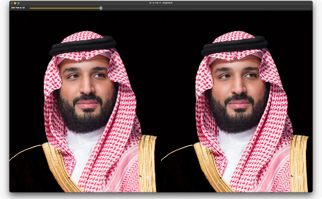
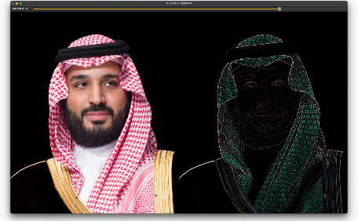
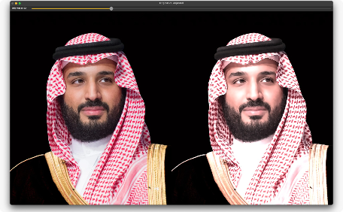
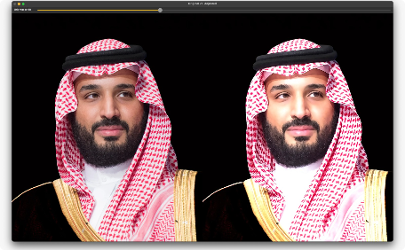
Image Filtering
Enhance without Filters
High Pass Filter
Vintage Filter
Increased Brightness

Slide 5
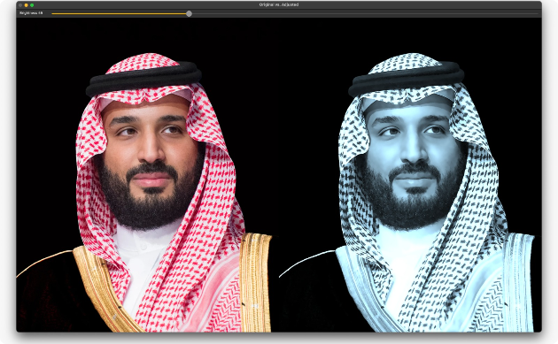
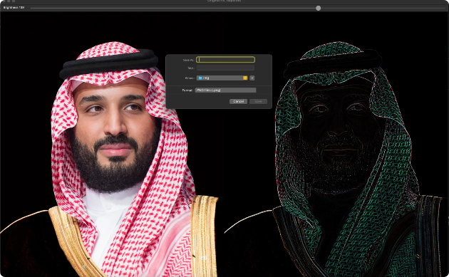
Image Filtering
Tone
Press ENTER to save

Slide 6
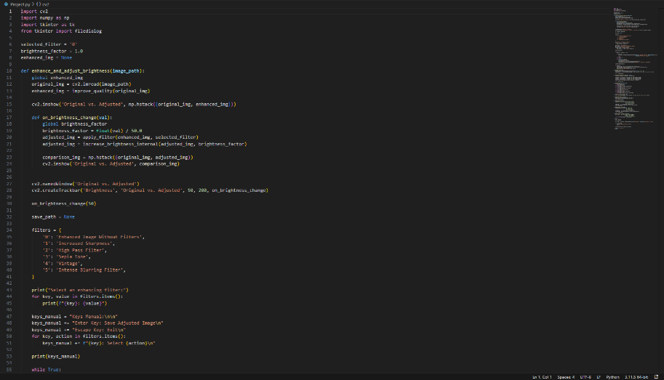
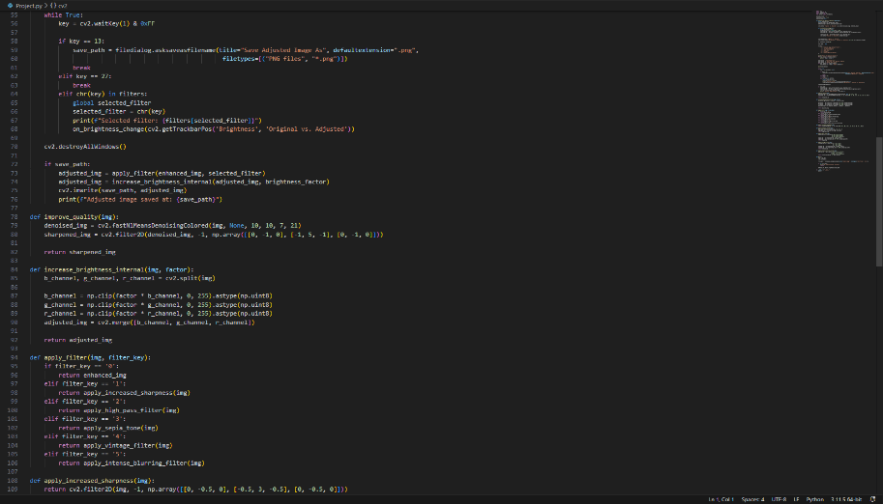
Coding

Slide 7
